Slide 2
Preparing for ALMA
http://science.nrao.edu/alma
National Radio Astronomy Observatory
North America ALMA Science Center
Charlottesville, Virginia U.S.

Slide 3
The Current Status of ALMA
Alison Peck
Joint ALMA Observatory

Slide 4
ALMA Specifications
54 12-m antennas, 12 7-m antennas, at 5000m site
Surface accuracy <25 μm, 0.6” reference pointing in 9m/s wind,
2” absolute pointing all-sky
Array configurations between 150m and ~15-18km
Angular resolutions ~40mas at 100 GHz (5mas at 900GHz)
10 bands in 31-950 GHz + 183 GHz WVR.
8 GHz BW, dual polarization.
Interferometry, mosaicing & total-power observing.
Correlator: 4096 channels/IF (multi-IF), full Stokes.
Data rate: 6MB/s average; peak 64 MB/s.
All data archived (raw + images), pipeline processing.

Slide 5
ALMA Sensitivity
50 antennas, 1-σ, 1 minute; AM=1.3; water values correspond roughly to the quartiles
Frequency GHz | Zenith Water mm | Continuum mJy | Line 1km/s * mJy
110 | 2.3 | 0.05 | 7
140 | 2.3 | 0.06 | 8
230 | 2.3 | 0.1 | 11
345 | 1.2 | 0.2 | 18
410 | 1.2 | 0.4 | 31
675 | 0.5 | 0.7 | 41
850 | 0.5 | 1.4 | 72
* Spectral line sensitivity scales inversely with square root of velocity resolution.
So for 25km/s, which might for example be used for a galaxy, divide by 5.

Slide 6
Early Science Capabilities
At least 16 antennas with 4 receiver bands
Number of antennas available will build up quite fast through
2011 and 2012. (Sensitivity goes as N, imaging complexity as N² .)
Baselines of at least 250m (1km goal) to start with, moving on to long
baselines in 2012.
Interferometry in single field or pointed mosaic mode, single-dish OTF
mapping for zero spacing.
Proper systems for user support in place:
proposal process
tools for preparing observations
data reduction package (CASA)
support from ALMA Regional Centers
Preparing for ALMA: 24 May 2010
6

Slide 7
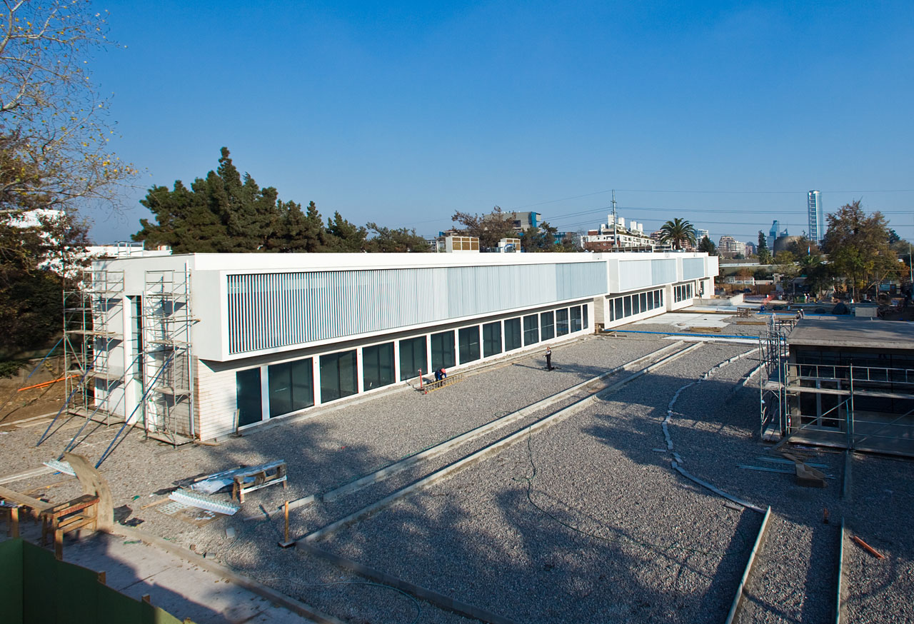
New Santiago Central Office Completion expected Aug 2010
Preparing for ALMA: 24 May 2010
7

Slide 8
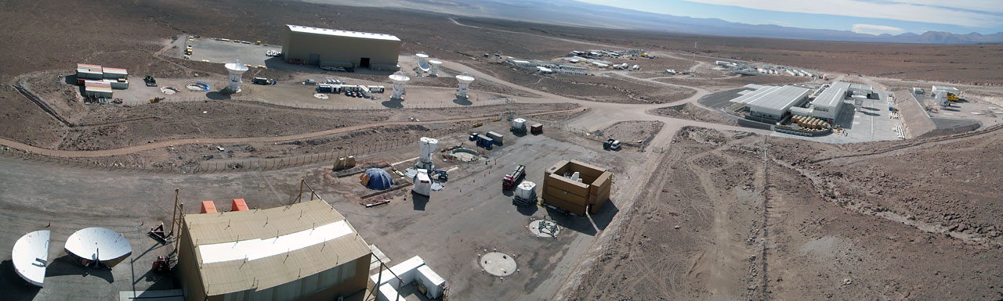
Current Shape of the OSF Seen from the holography tower
Staff cafeteria and dorms
Vertex Camp
Construction Camp
MElCo Camp
Technical Facility
Offices and Labs
Antenna Test
Stations
AEM Camp
Preparing for ALMA: 24 May 2010
8

Slide 9
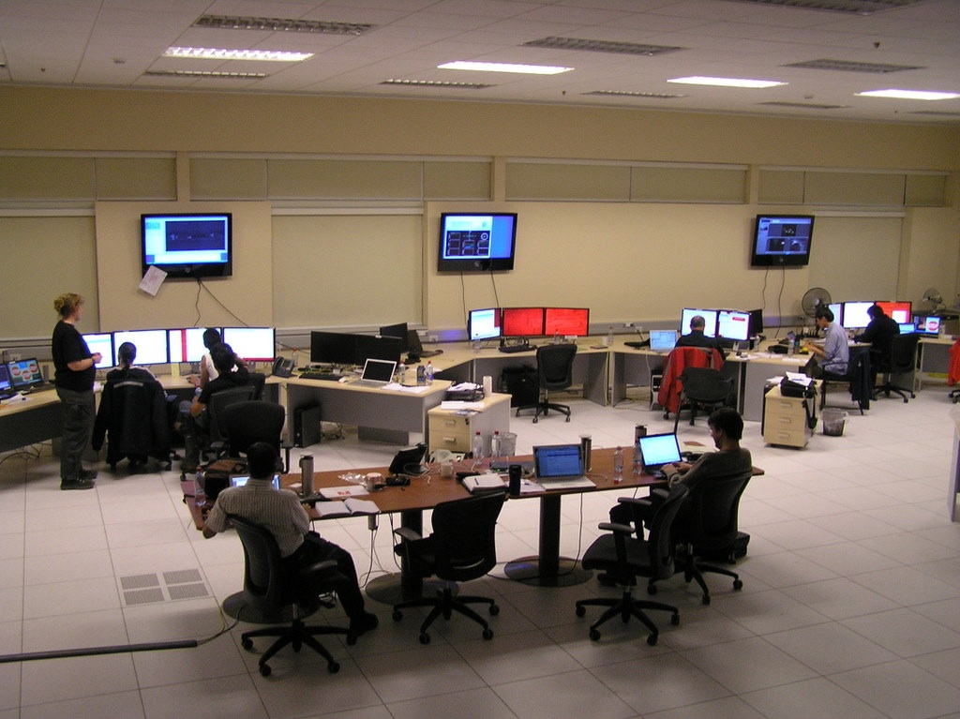
Control Room - OSF (evening shift)
Preparing for ALMA: 24 May 2010
9

Slide 10
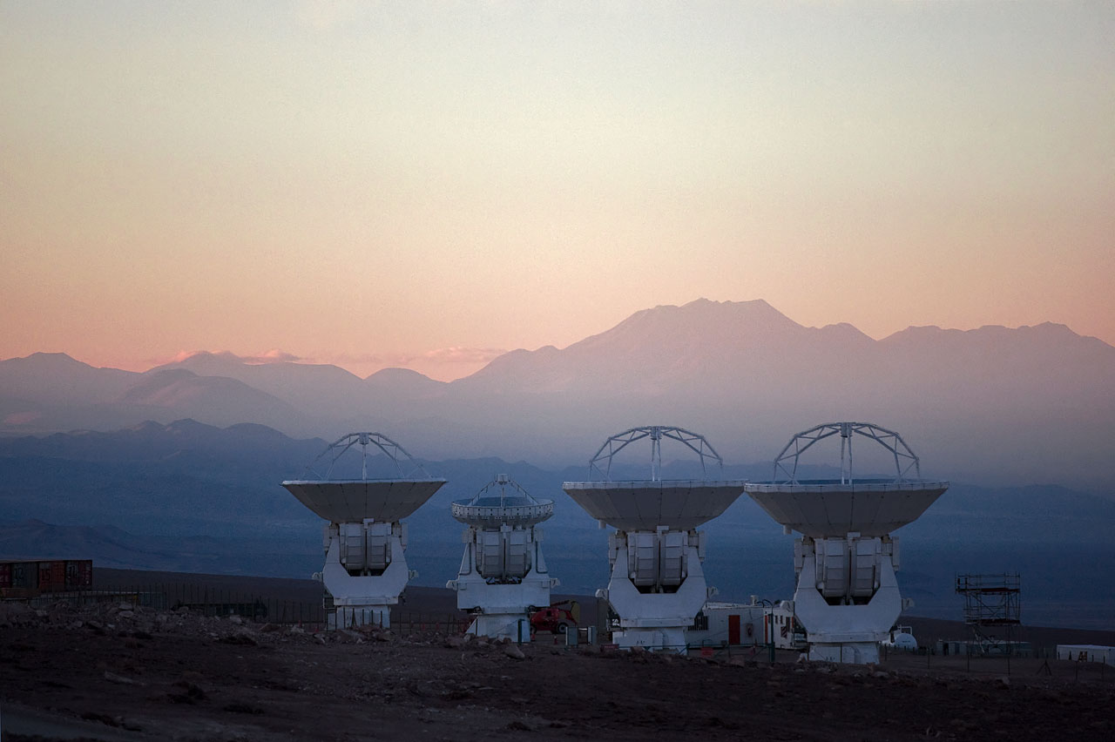
MElCo Antennas - three 12m and one 7m
Preparing for ALMA: 24 May 2010
10

Slide 11
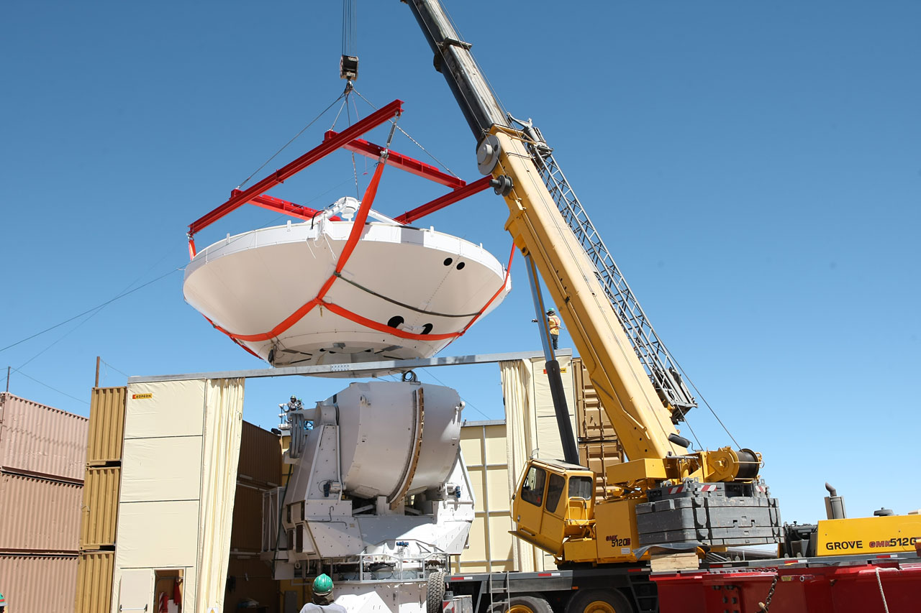
AEM Antenna Assembly at the OSF
Preparing for ALMA: 24 May 2010
11

Slide 12
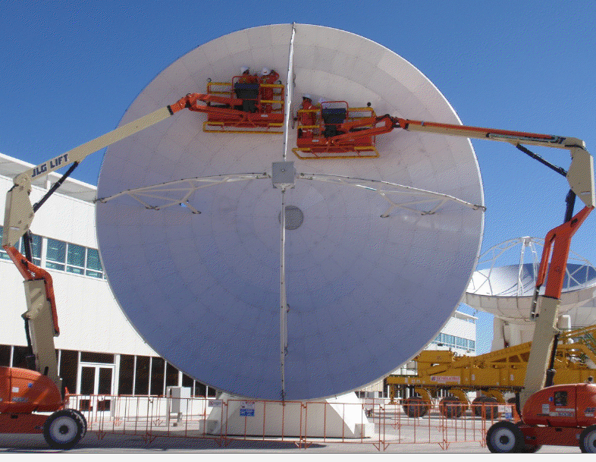
Teams Trained for Panel Setting

Slide 13
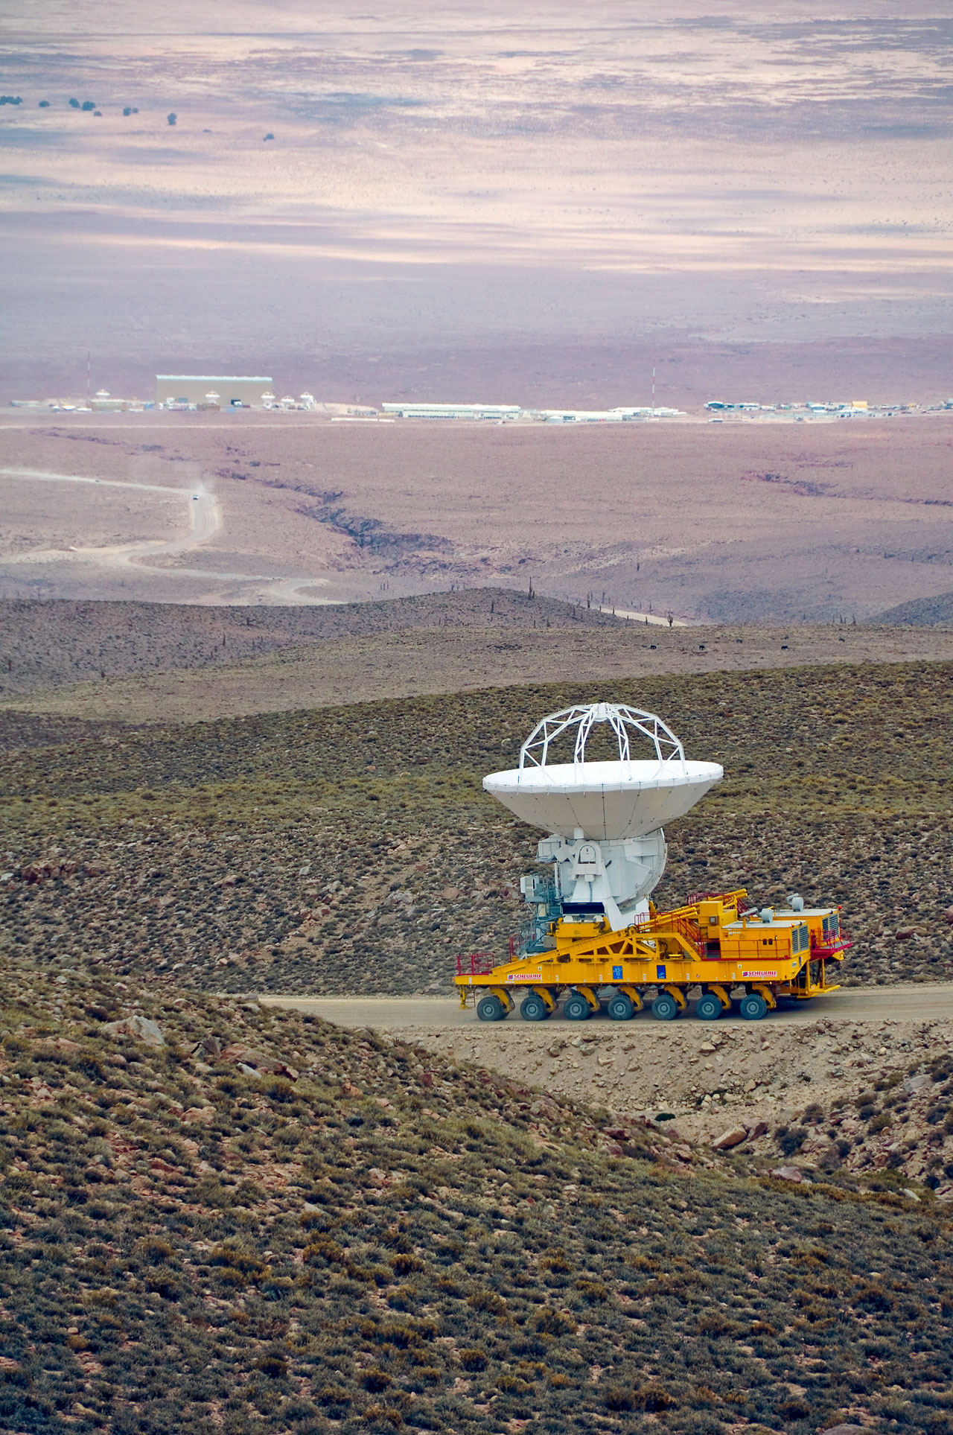
DV01 makes the climb from the OSF to the AOS (2009)
Preparing for ALMA: 24 May 2010
13

Slide 14
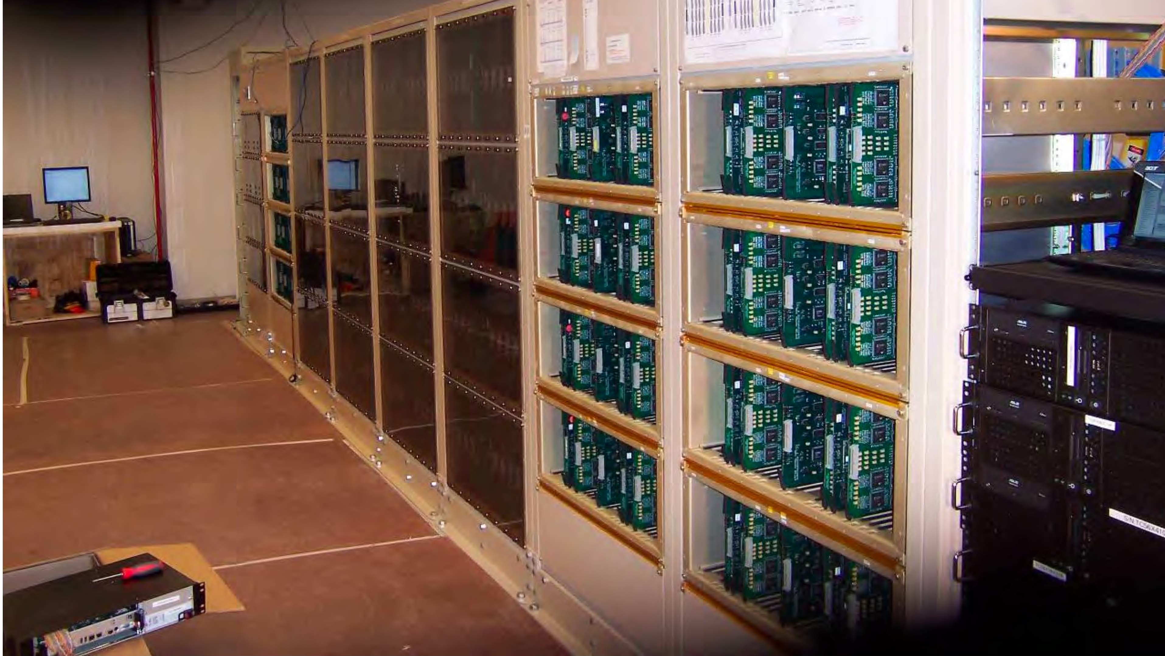
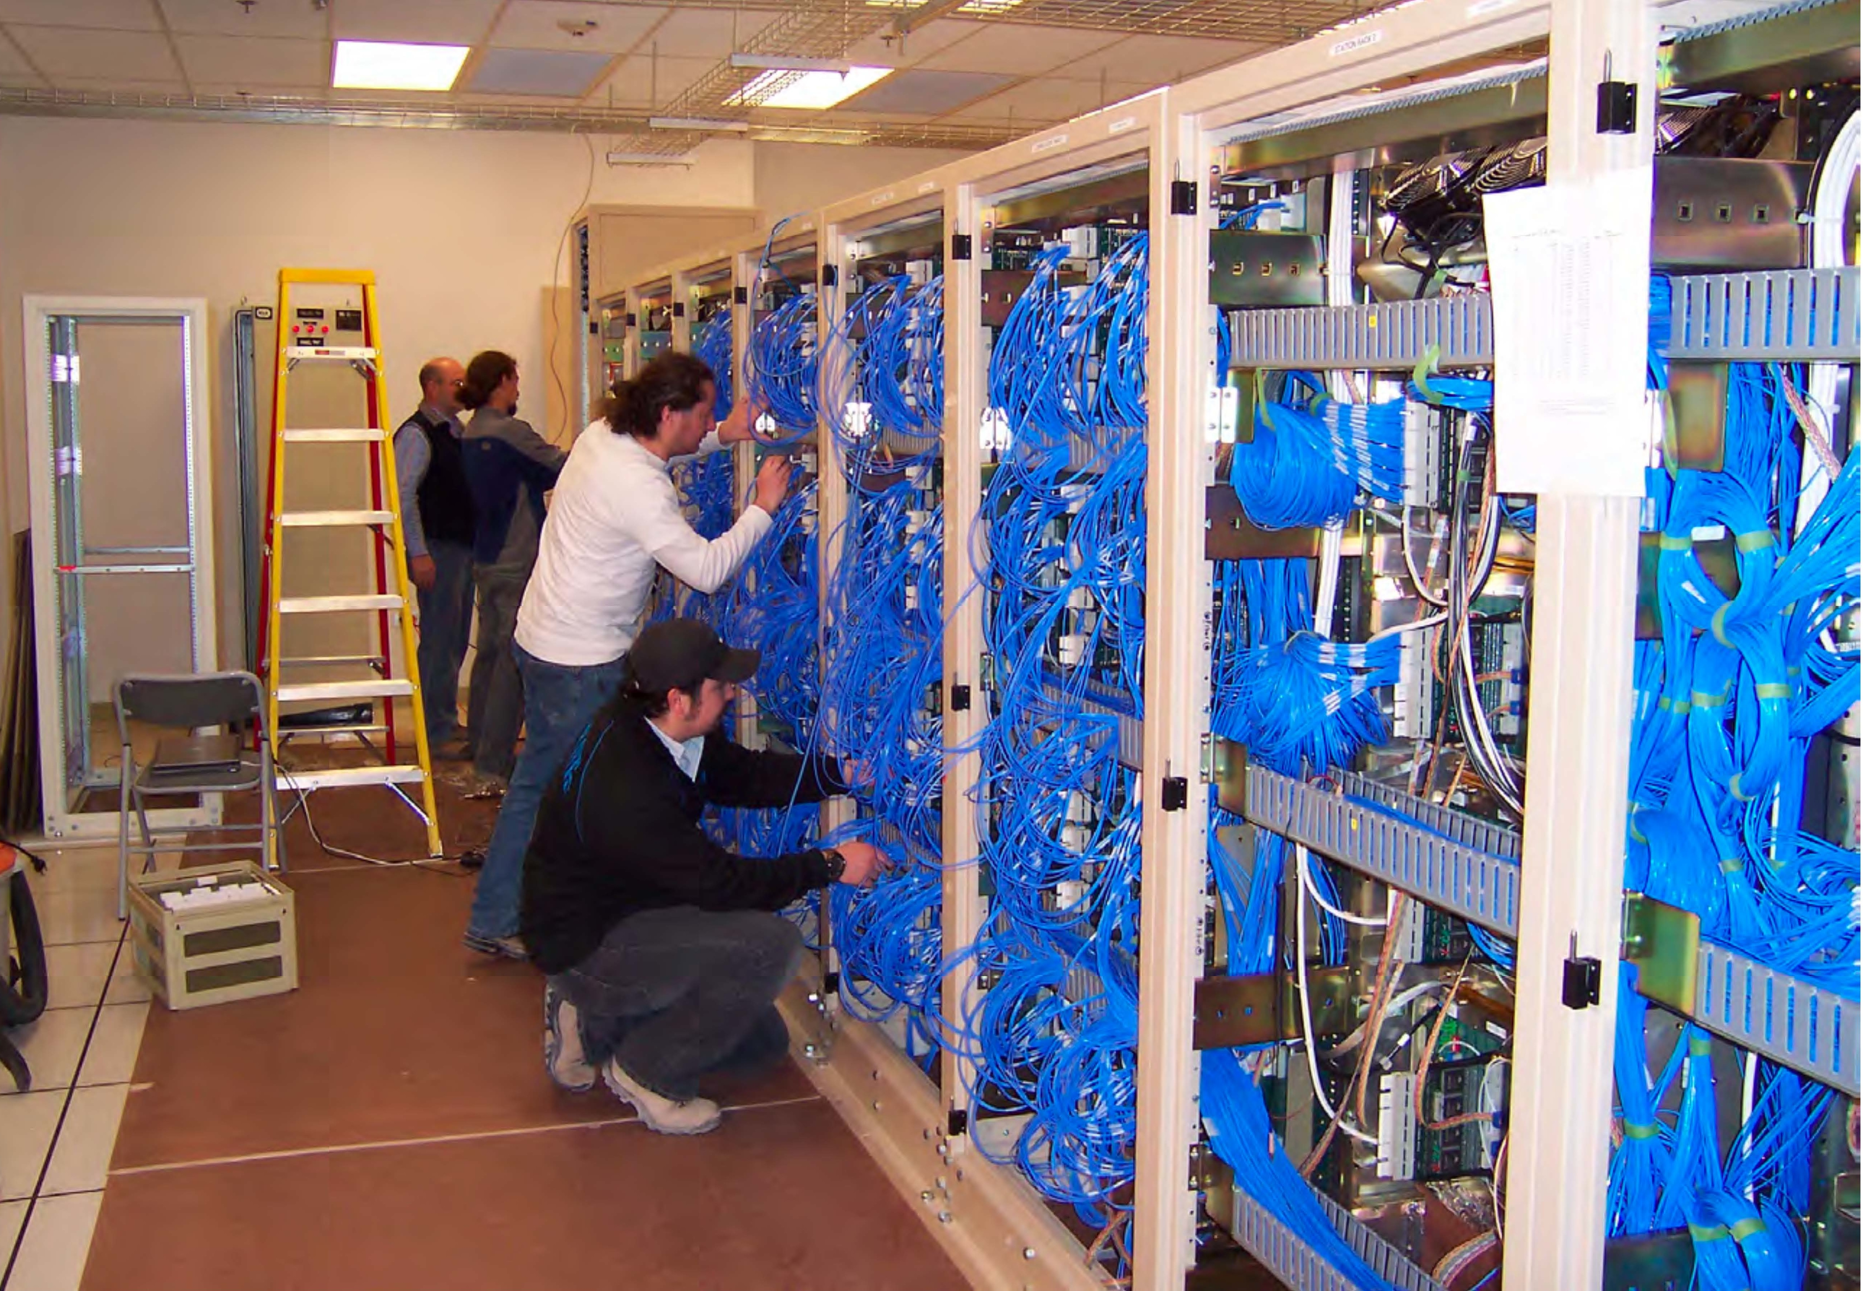
Correlator First Quadrant at AOS

Slide 15
Configurations Leading to Inauguration
Phase 0 Sep ’09 1 pad for antenna checkout
Phase 1 Oct ’09 3 pads for first fringes / closure
Phase 2 Jan ’10 10 ACA pads - initial commissioning
Phase 3 Jul ’10 add 6 inner array pads
Phase 4 Mar ’11 for Early Science - central cluster plus 20 inner array pads
Phase 5 Oct ’11 high resolution – baselines to ~ 4km
Phase 6 Apr ’12 goal for completion of outer array
Preparing for ALMA: 24 May 2010
15

Slide 16
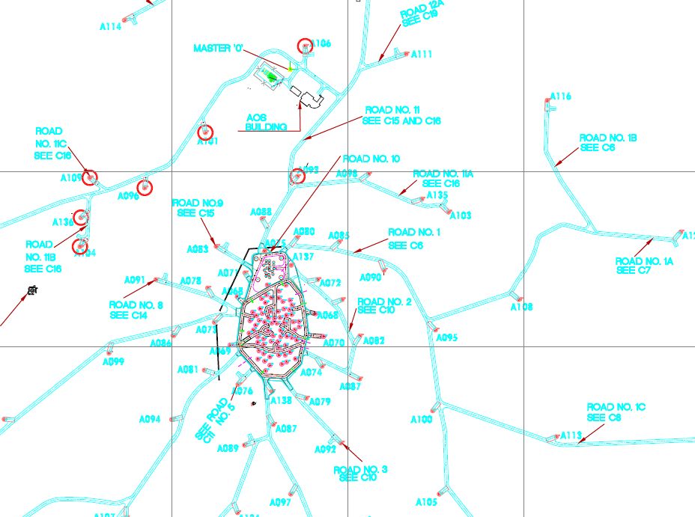
Antenna Station Locations
Phase 1
Phase 4
Phase 3
Phase 2
Preparing for ALMA: 24 May 2010
16

Slide 17
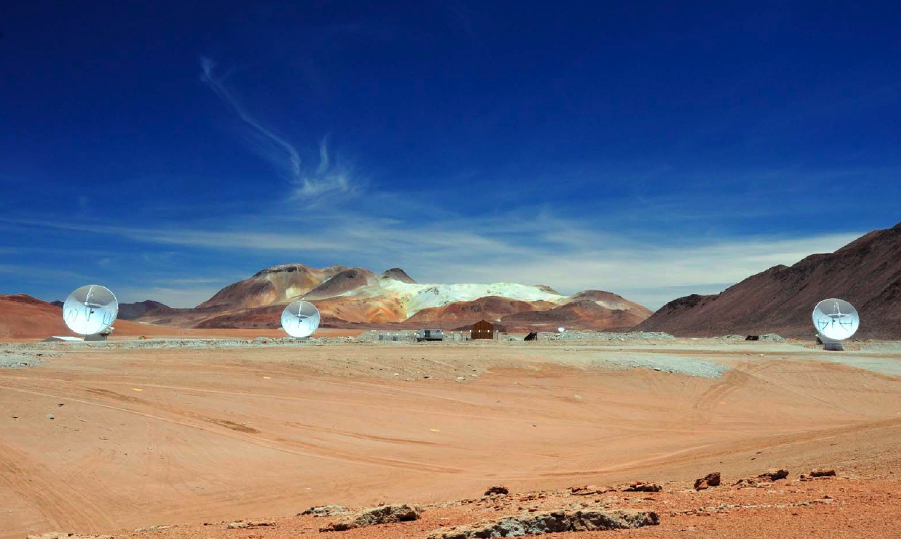
Long Baselines in Phase 1 Array
Preparing for ALMA: 24 May 2010
17

Slide 18
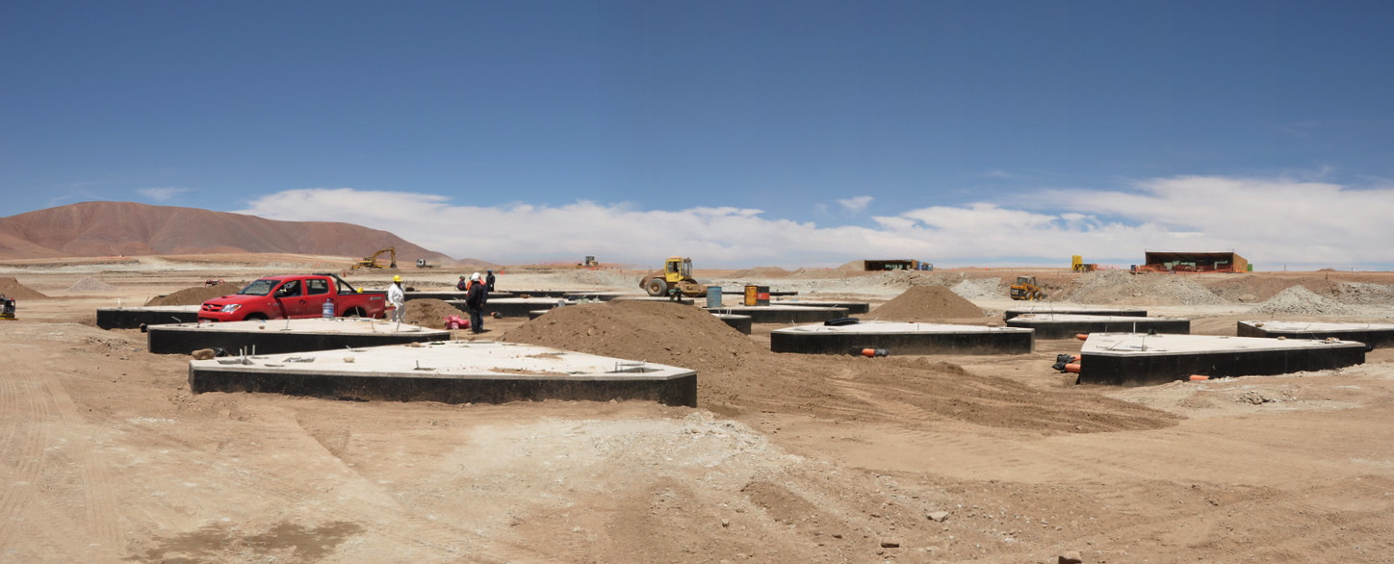
Construction of ACA Stations (2009)
Preparing for ALMA: 24 May 2010
18

Slide 19
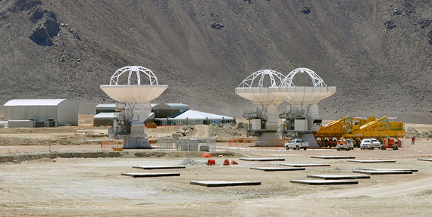
No joke! Third antenna joins the Compact Array on April 1, 2010
Preparing for ALMA: 24 May 2010
19

Slide 20
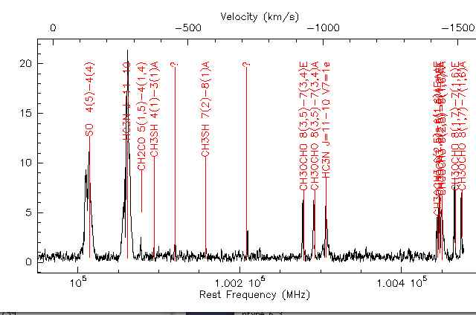
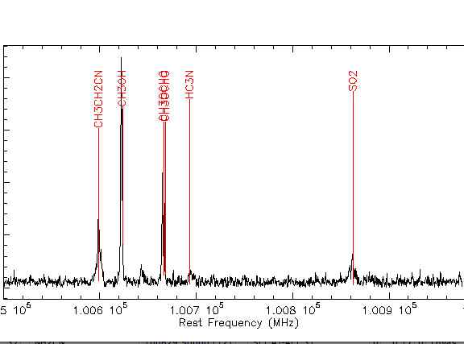
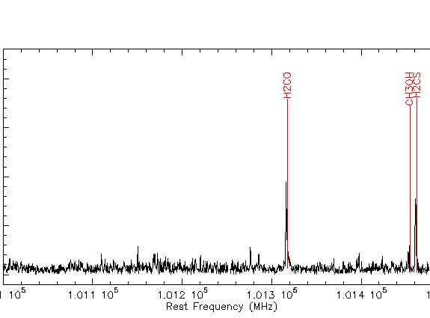
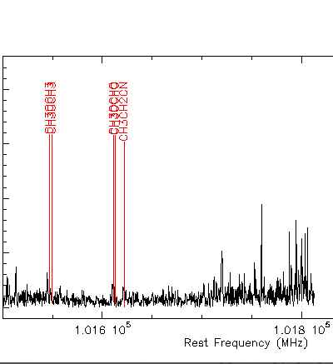
Interferometric spectrum: Orion - 101 GHz, April 2008
Taken at ATF, not using production receivers, but verifying software for control, tuning, correlator and data reduction
Preparing for ALMA: 24 May 2010
20

Slide 21
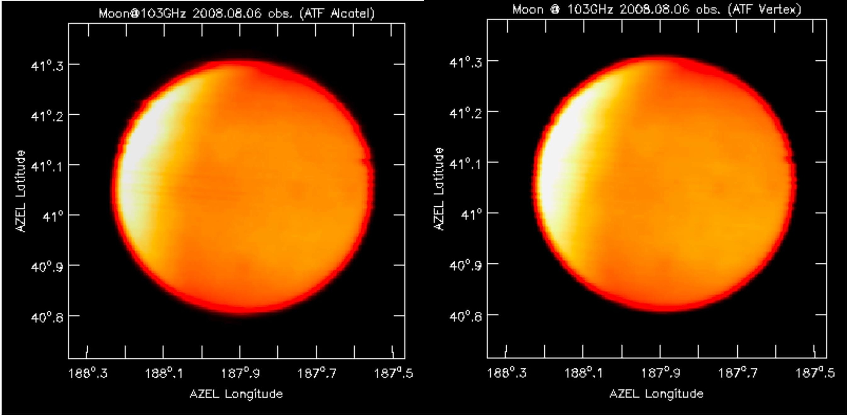
Single Dish On-the-Fly Mapping Early e2e software test, Moon with 2 antennas simultaneously
Preparing for ALMA: 24 May 2010
21

Slide 22
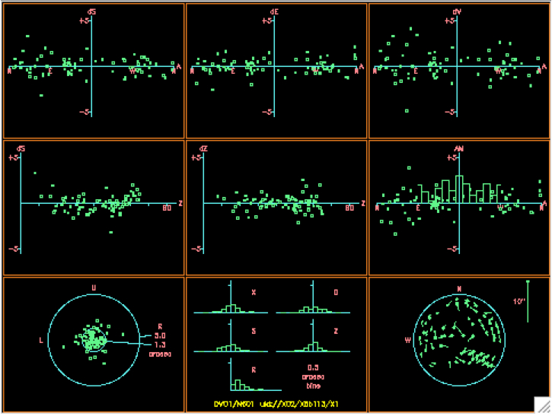
Weekly Pointing Monitoring
DV01
rms=1.8”
Preparing for ALMA: 24 May 2010
22

Slide 23
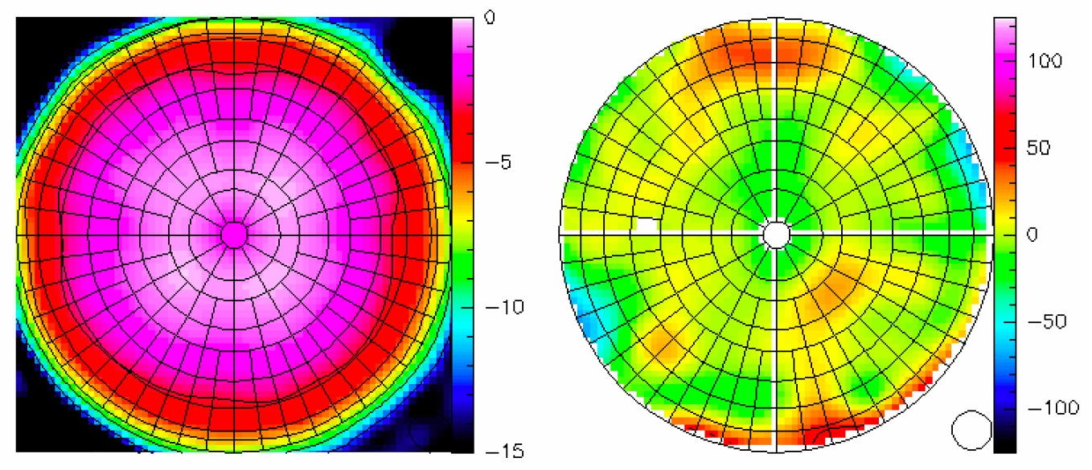
Astronomical Holography 3C279 at 81º elevation
Illumination
Surface
Preparing for ALMA: 24 May 2010
23

Slide 24
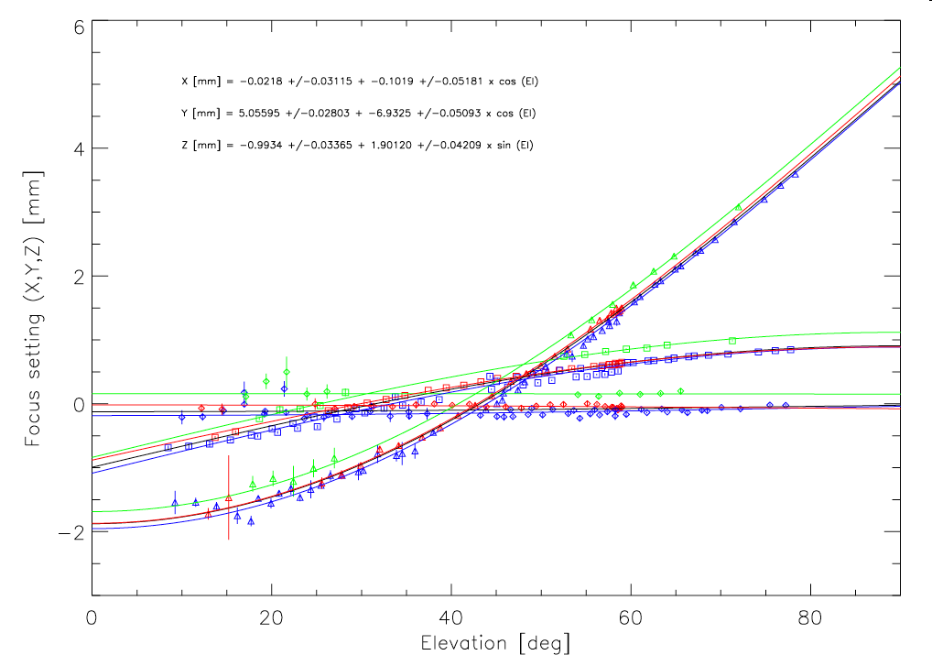
Measuring Focus Curves
Preparing for ALMA: 24 May 2010
24

Slide 25
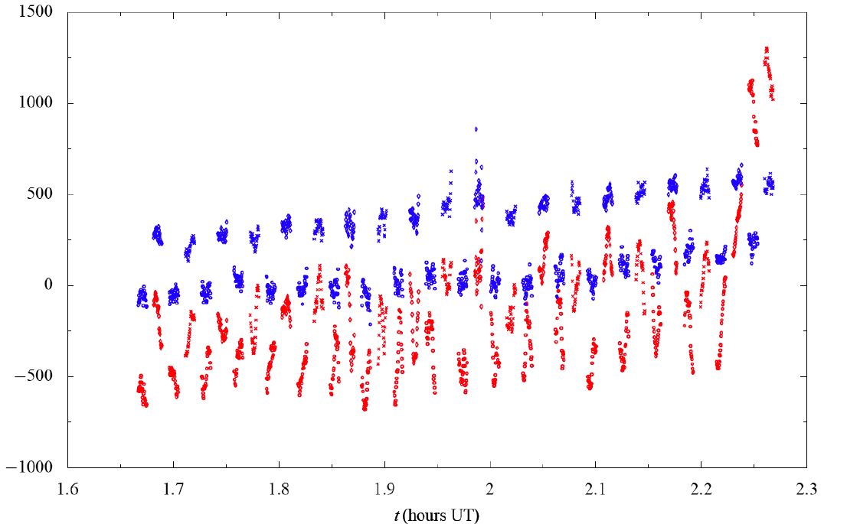
Water Vapor Correction Cycling between 3C273, 3C279, Pluto; blue=corrected
Preparing for ALMA: 24 May 2010
25

Slide 26
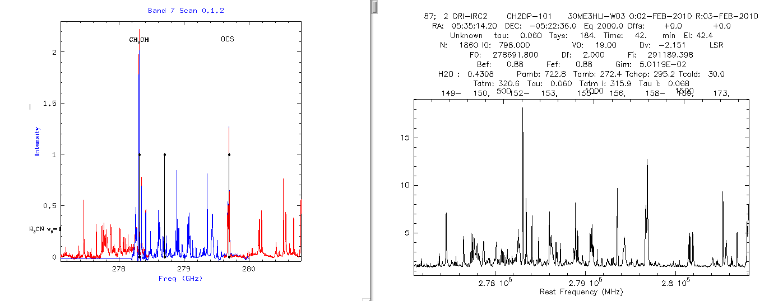
Recent Band7 (345 GHz) Spectrum of Orion Comparison with IRAM 30m

Slide 27
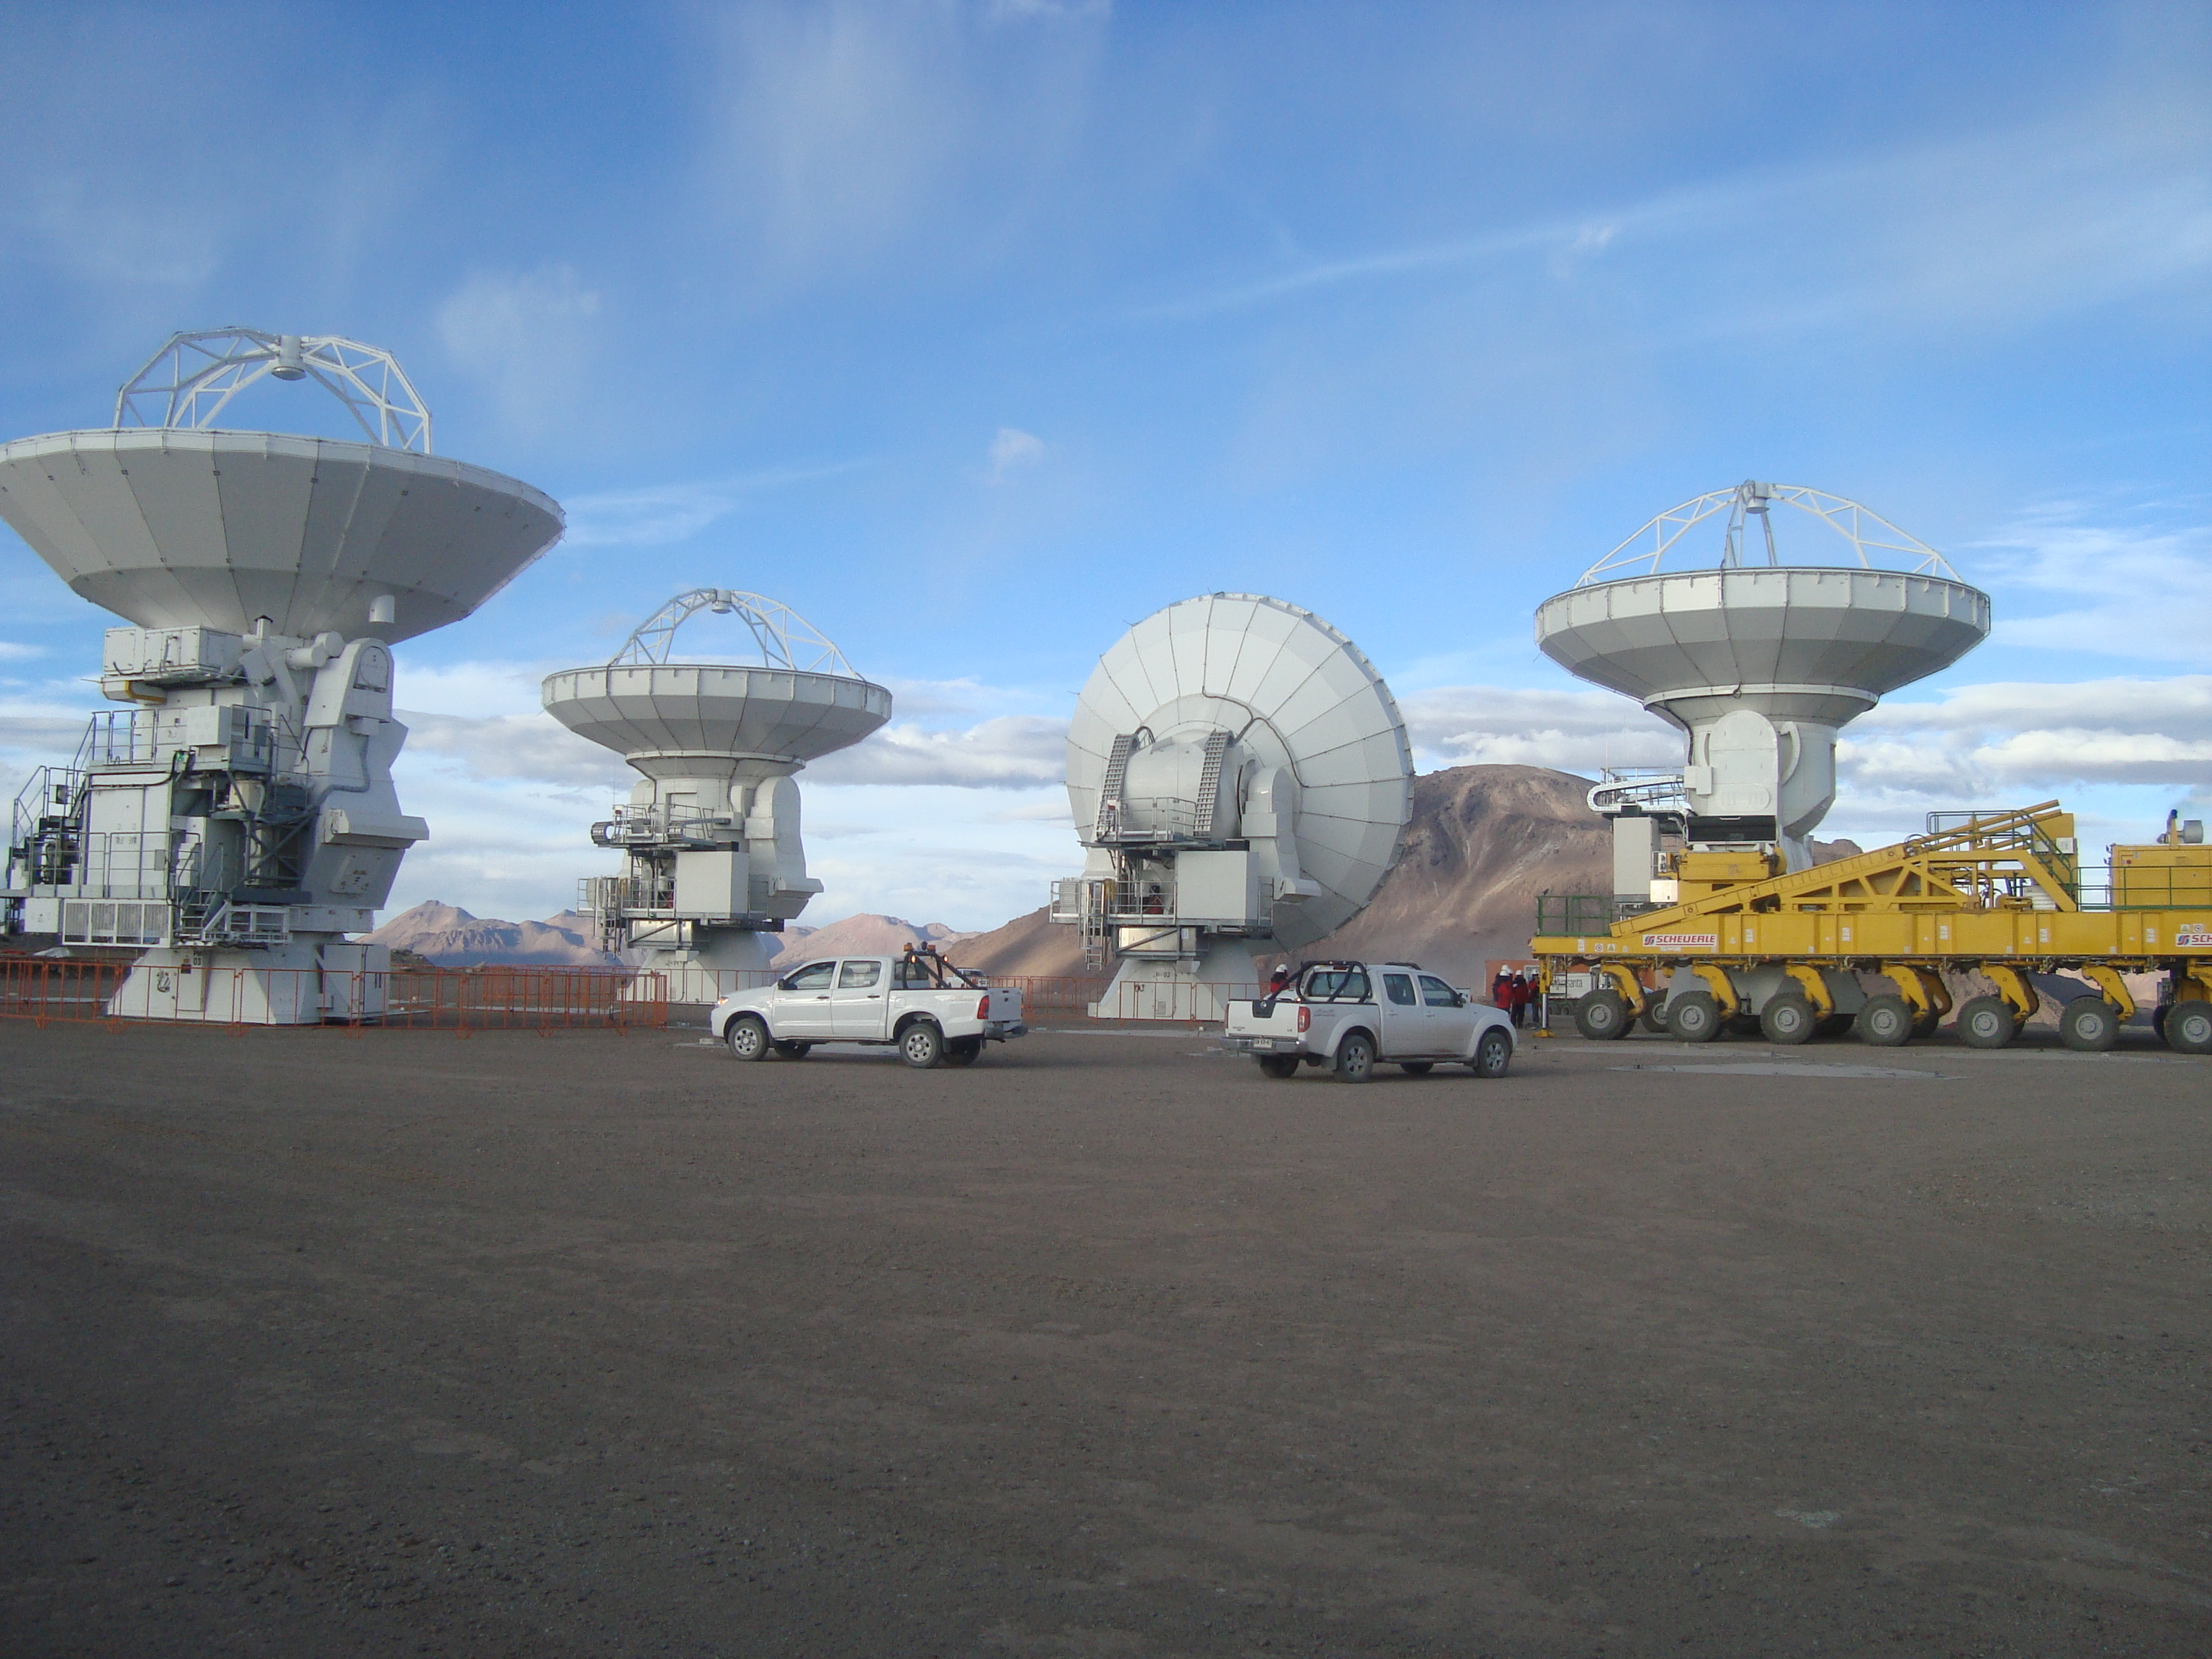
May 2010, AOS First fringes using all 4 antennas May 21, 2010
Preparing for ALMA: 24 May 2010
27

Slide 28
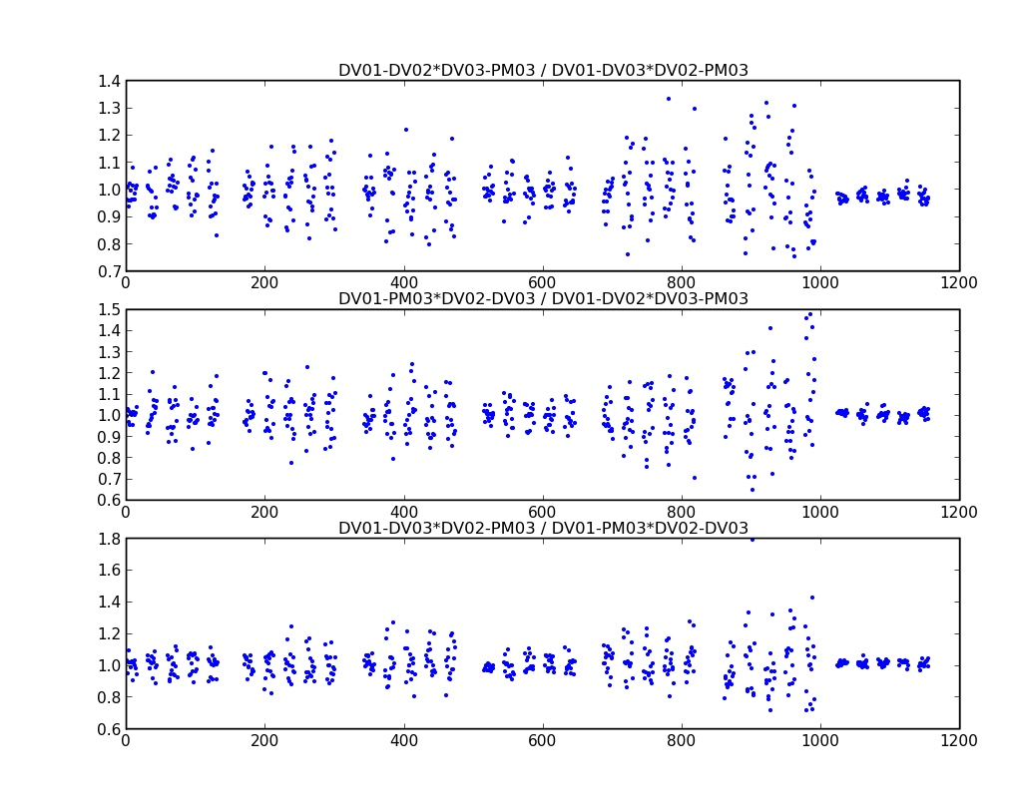
Amplitude Closure! Several sources, including Jupiter and qsos, data analysis has begun

Slide 29
Next Steps:
Commissioning and Science Verification in full swing throughout 2010/11
4+ antennas:
Further test observing modes:
Single field interferometry
Pointed mosaic
Single dish on-the-fly for zero spacing
Automated monitoring modes (pointing, calibrator survey)
6+ antennas:
Refine calibration strategies
Better imaging
Call for proposals for Early Science end of 2010.
Early Science start in second half of 2011.
Preparing for ALMA: 24 May 2010
29

Slide 30
How you can be involved…
Current job advertisements:
https://careers.nrao.edu
http://hr.almaobservatory.org/jobs/opportunities/
Visitor’s program:
Some support (typically at least travel and lodging) for people who can take
leave or sabbatical from their home institutions to participate in CSV.
Open through 2011
Stays of 3 months to 1 year recommended
No proprietary data during this period
Contact me for more information at apeck@alma.cl
Preparing for ALMA: 24 May 2010
30

Slide 31
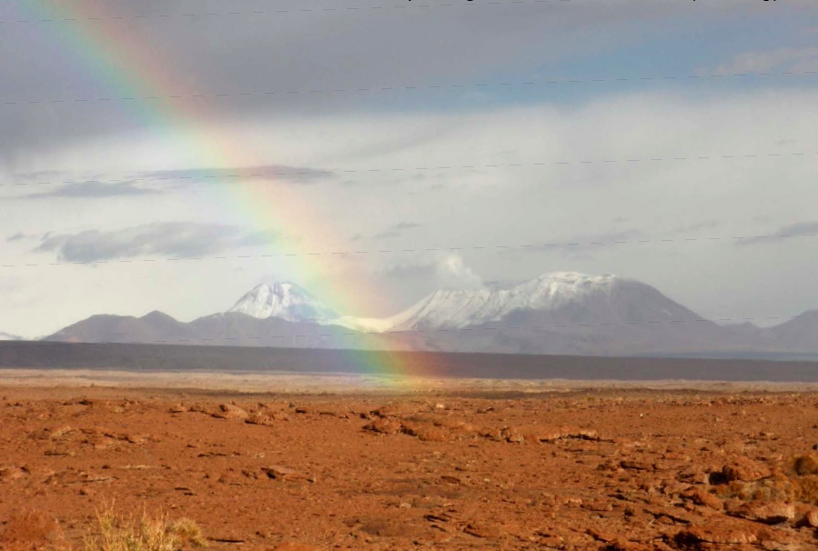
For more info on current status:
http://www.almaobservatory.org
The Atacama Large Millimeter/submillimeter Array (ALMA), an international astronomy facility, is a partnership of Europe, North America and East Asia in cooperation with the Republic of Chile. ALMA is funded in Europe by the European Organization for Astronomical Research in the Southern Hemisphere (ESO), in North America by the U.S. National Science Foundation (NSF) in cooperation with the National Research Council of Canada (NRC) and the National Science Council of Taiwan (NSC) and in East Asia by the National Institutes of Natural Sciences (NINS) of Japan in cooperation with the Academia Sinica (AS) in Taiwan. ALMA construction and operations are led on behalf of Europe by ESO, on behalf of North America by the National Radio Astronomy Observatory (NRAO), which is managed by Associated Universities, Inc. (AUI) and on behalf of East Asia by the National Astronomical Observatory of Japan (NAOJ). The Joint ALMA Observatory (JAO) provides the unified leadership and management of the construction, commissioning and operation of ALMA.
Preparing for ALMA: 24 May 2010
31

Slide 32
PREPARING FOR ALMA
http://science.nrao.edu/alma
National Radio Astronomy Observatory
North America ALMA Science Center
Charlottesville, Virginia U.S.

